Slide 1

Git Dashboard:
BHAVAN’S GANGABUX KANORIA VIDYAMANDIR
a site for developers
Interactive, assistive, and always up to date.
Anushka Mitra | Chandramouli Das

Slide 2
The 3 Main Features
Node graph | The size of the node is determined by complexity and it is colour coded by churn metrics.
Contextual Blame Chatbot | It helps identify weaknesses, show past pull requests and author intentions.
Refactor Sandbox | Previews modernised code side by side with legacy code.

Slide 3
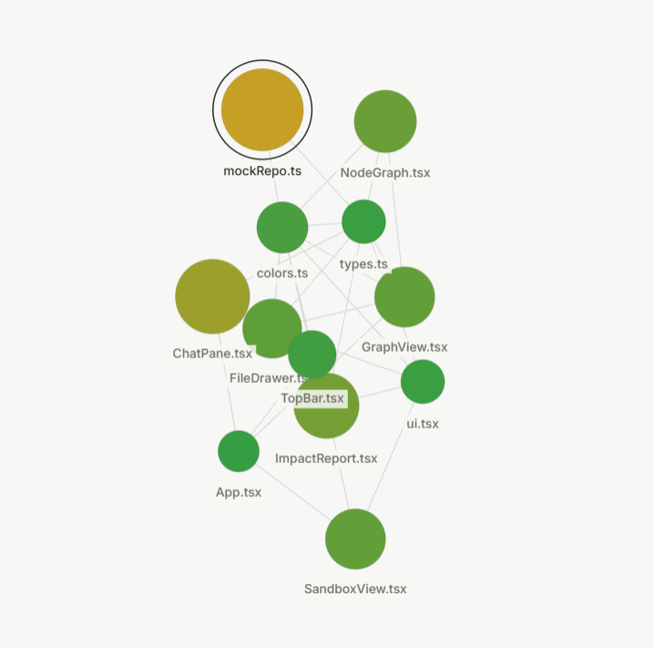
Interactive Node Graph
IN-DEPTH LOOK:
NODES
LINES
Problem: Code smells, anti-patterns, and tech debt remain hidden across nested directories.
Solution: Files are shown as interactive nodes on an HTML5 canvas. The node size signifies cyclomatic complexity and colour relates to code churn metrics. This makes problem code modules visually stand out.
Problem: Modifying closely linked components often leads to unexpected problems across its linked systems.
Solution: By rendering directional dependency links between nodes, they can map exactly what code sections will be impacted prior to refactoring.

Slide 4
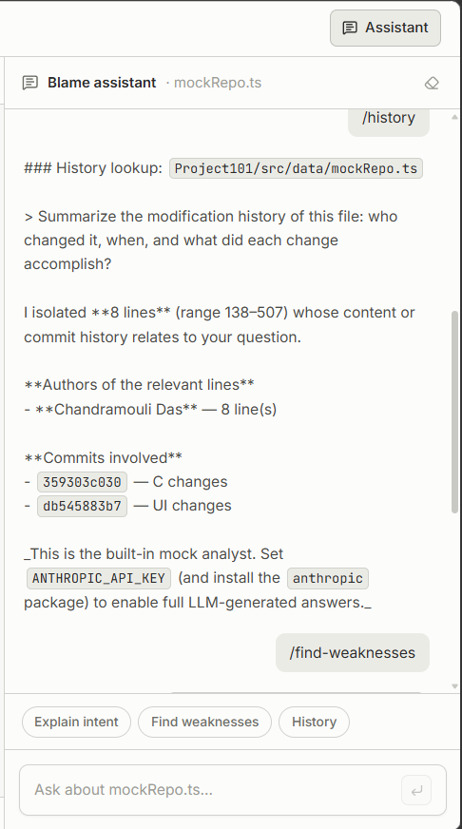
Contextual Blame Chatbot
IN-DEPTH LOOK:
Problem: New devs coming into into legacy codebases have to manually trace logs (git log, git blame) to know original author intent and all the previous structural shifts.
Solution: This architecture allows to view source code with version history. By feeding file snapshots, version histories, and line-by-line blame metadata into an LLM context window, developers can run chat queries directly against a file's lineage right inside the website.

Slide 5
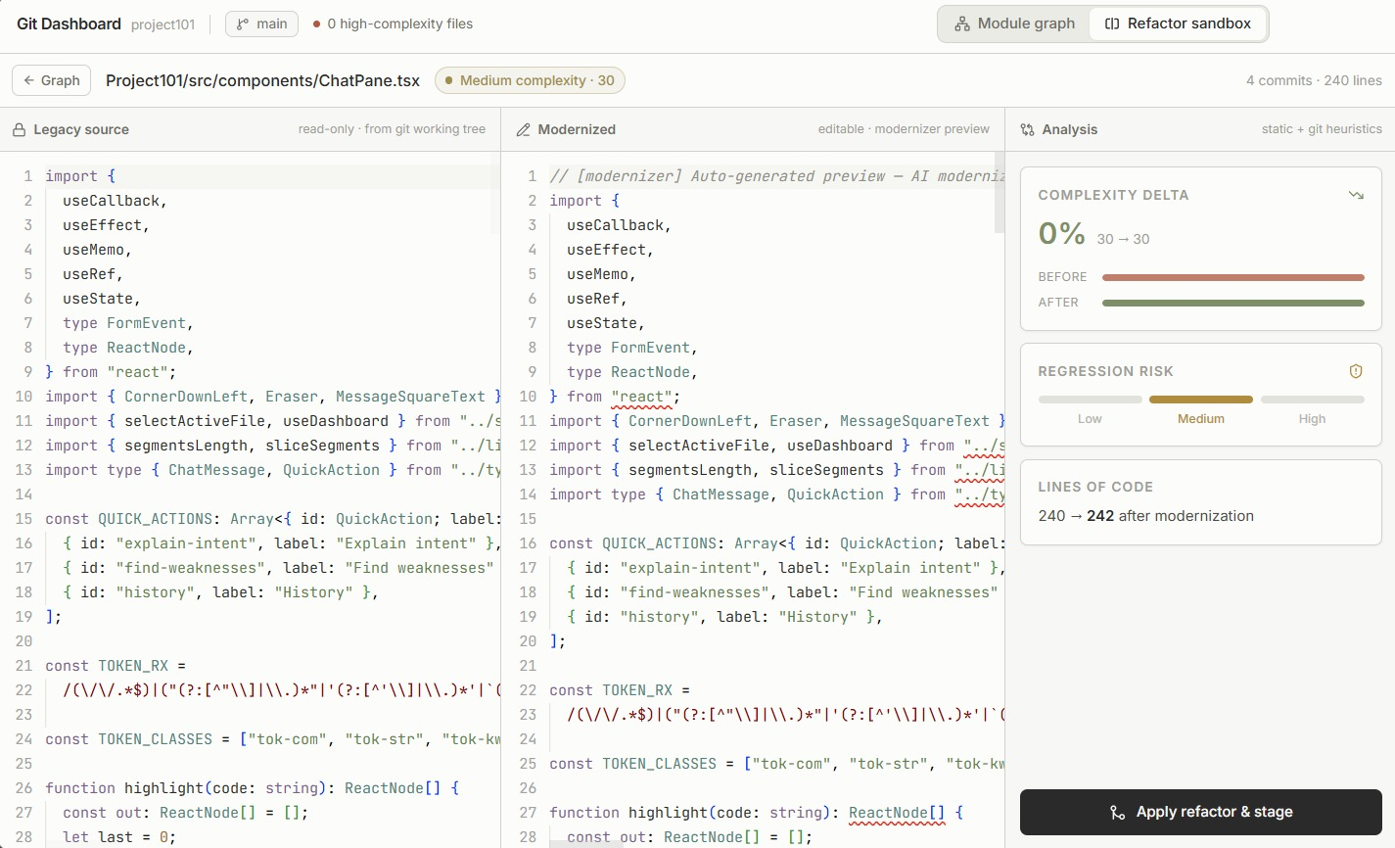
Refactor Sandbox
IN-DEPTH LOOK:
When an engine node is selected, a split pane view opens up.
Left Window: Automatically mounts in a read-only configuration, displaying the legacy file contents retrieved from the data contract.
Right Window: Placed side-by-side to serve as a modification sandbox, this pane Renders proposed refactoring changes with full syntax support.

Slide 6
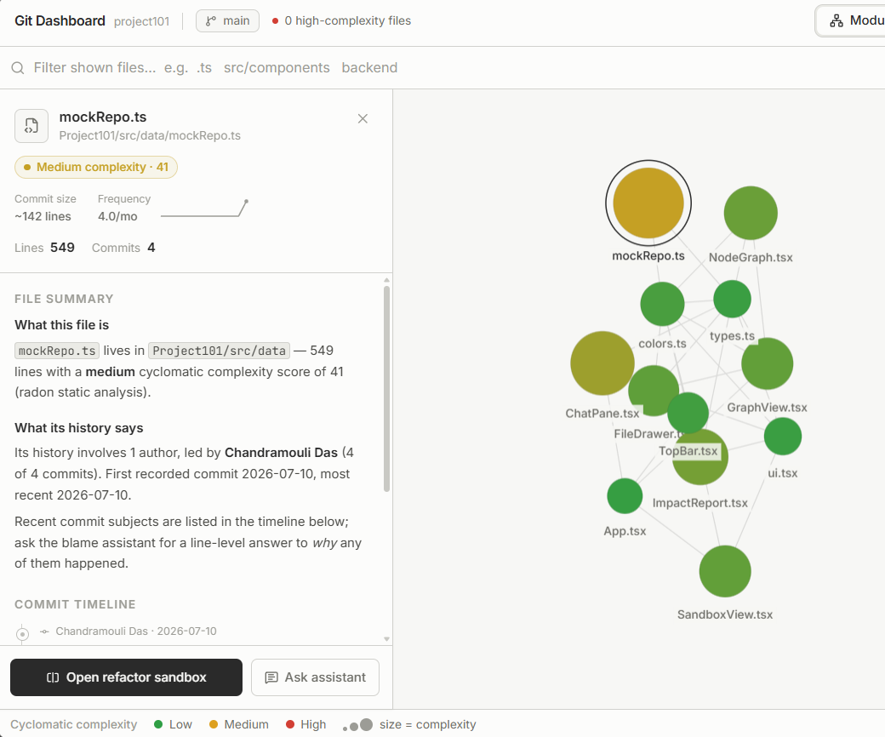
System Fonts and Designs
UI-UX STYLES:
Canvas Background: Low-contrast, flat warm grey shades (#F7F7F2 or #EFEFE9).
Component Borders: Fine, single-pixel grey lines (#D4D4CC), no heavy Drop Shadows or dark card backdrops.
Typography Hierarchy: Renders high-legibility fonts for controls, sidebar labels, and metadata readouts. Monospace layout treatments are strictly restricted to code viewports.
Graph Complexity Nodes: Green marks low complexity, Transitional colours (like yellow) flags moderate structural debt, and Red highlights high-risk files.

Slide 7
Prospective User Base
1. Onboarding Developer:
They don't know which files are dangerous to touch or why certain decisions were made in years-old codebases.
So they can use the Node Graph to see the "hotspots" and the Chatbot to ask, "Why is this logic so complex?"
2. Mergers & Acquisitions:
When a big company buys a smaller startup, they need to audit the code quality quickly. So they plug the startup's repo into the dashboard to instantly see the Complexity vs. Churn ratio.
3. Tech Leads & Software Architects:
They know the system has technical debt, but they can't easily show it to management to justify a refactor.
So they use the Visual Risk Map (Red vs. Green nodes) to instantly show stakeholders where the weak parts of the system are.

Slide 8
Conclusion
Our dashboard shows live updates and their intentions. The insights already exist in Git; the dashboard surfaces them.
Engineers, leads, and PMs share the same info that always stays up to date.
It helps in early bottleneck detection and incentivises people to fix or remove it instead of frequent patching.
It allows developers to focus on writing code instead of creating status updates.

Slide 9
Thanks!
Working on this project was a wonderful opportunity and we had a lot of fun as well as learnt new skills ☺

